Slide 1
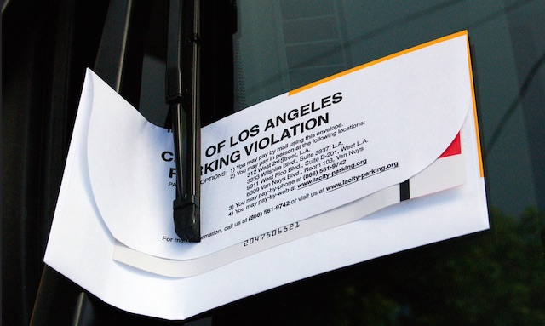
Los Angeles Parking Citations
Group Members: Marisabel Chang Oakar Kyaw Thet Soe

Slide 2
Los Angeles Parking Citations
Analyze the Los Angeles Parking Citation DataSet
Top 20 Violation Description (779 type of citations)
Issue time
Near issue time
Between issue time
Issue Date- Day of week
Serial Models
Cloud - GPU.
Local environment.

Slide 3
Dataset
Los Angeles Parking Citations 2015 - Present
Source: Kaggle - Los Angeles Parking Citations
Format: Csv
Size: 1.11 GB

Slide 4
Model Planning
Python
Pandas
Mathplotlib
Jupyter Notebook
Ipyparallel - IPython’s architecture for parallel and distributed computing
Google Collaboratory- free Jupyter notebook environment that requires no setup and runs entirely in the cloud.
Clear data.
Use Mathplotlib to show data results
Group violation descriptions, issue time, issue date

Slide 5
Result
Local Machine - Execution time: 445 seconds
Google Collaboratory - Execution time: 119 seconds
Number of Parking Citations: 8,434,069 (2015-2018)
Total Fine:$ 590,644,016.00

Slide 6
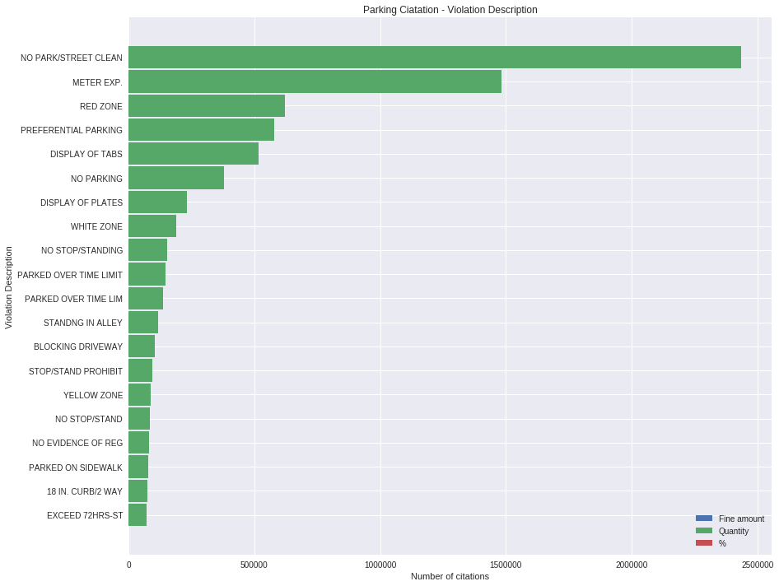
Top 20 Violation Descriptions
Violation Description | Fine Amount | Quantity | %
NO PARK/STREET CLEAN | 73.00 | 2,434,742 | 28.9
METER EXP. | 63.00 | 1,483,118 | 17.6
RED ZONE | 93.00 | 621,533 | 7.4
PREFERENTIAL PARKING | 68.00 | 580,289 | 6.9
DISPLAY OF TABS | 25.00 | 51,7651 | 6.1

Slide 7
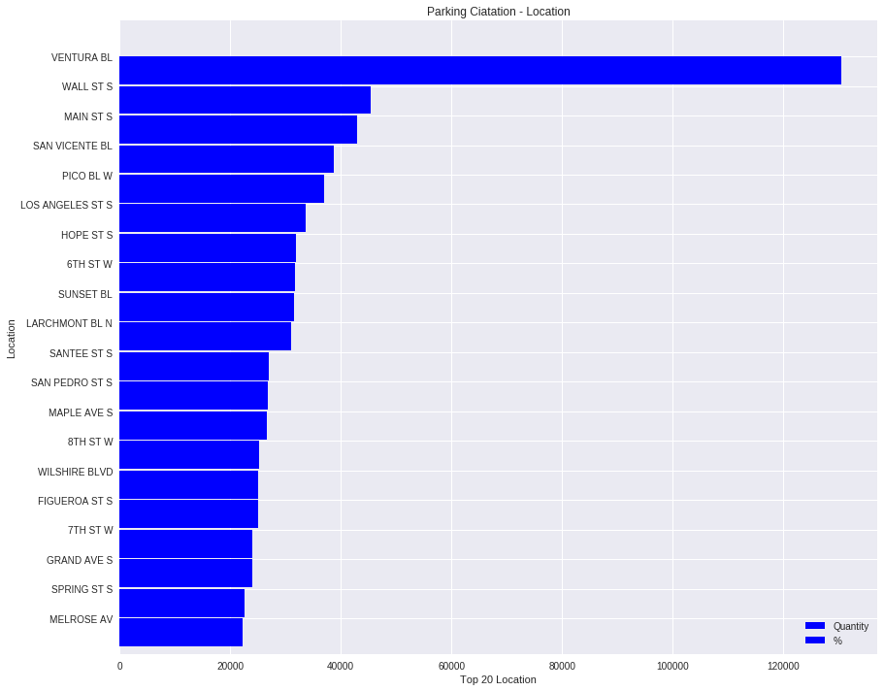
Location
Location | Quantity | %
Ventura BL | 130,481 | 1.55
Wall St | 45,413 | 0.53
Main St | 42,972 | 0.50
San Vicente BL | 38,732 | 0.46
Pico BL | 37,002 | 0.43
LOS ANGELES ST | 33,695 | 0.40
Data: 142,804 locations

Slide 8
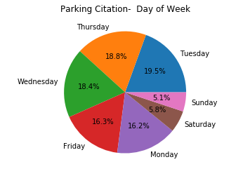
Issue Date
Day of Week | Quantity | %
Tuesday | 1,640,958 | 19.5
Thursday | 1,584,621 | 18.8
Wednesday | 1,552,237 | 18.4
Friday | 1,374,309 | 16.3
Monday | 1,365,862 | 16.2
Saturday | 485,931 | 5.8
Sunday | 42,963 | 5.0

Slide 9
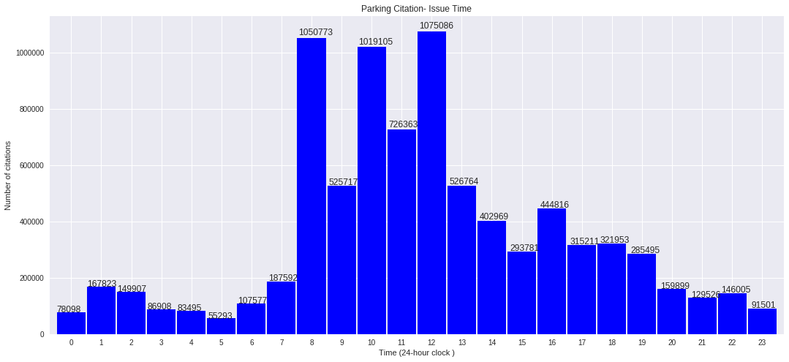
Issue Time - Between Issue Time

Slide 10
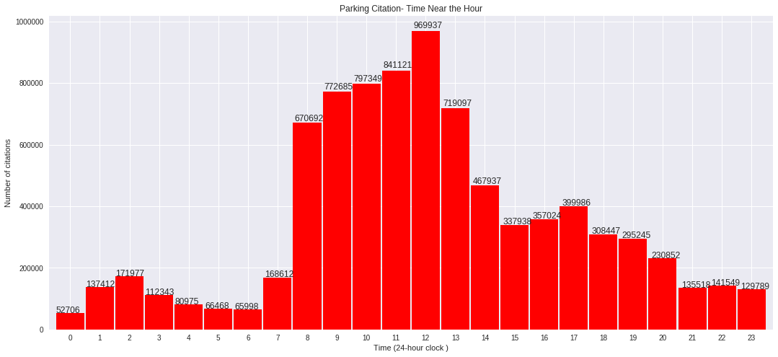
Issue Time - Near Issue Time

Slide 11

Demo
Google Collaboratory- free Jupyter notebook environment that requires no setup and runs entirely in the cloud.

Slide 12
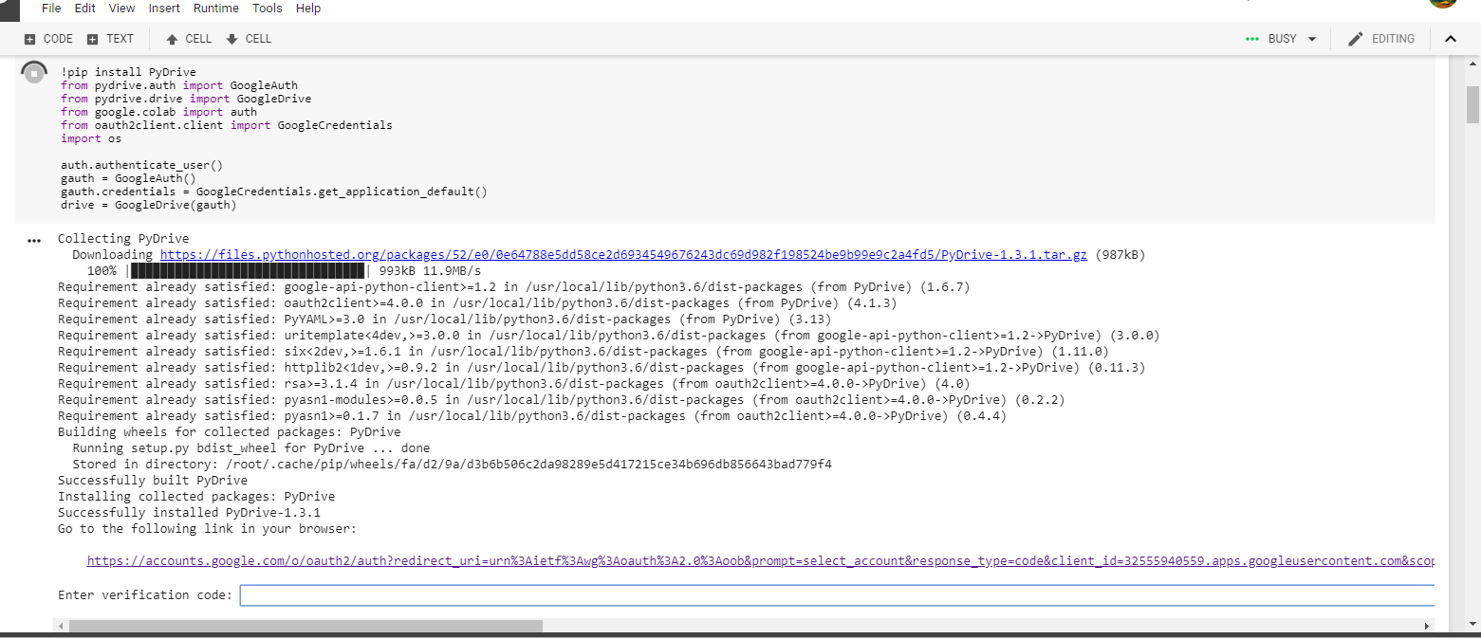
Google Authorization
- Run the block that ask for google authorization
-Click the link is in the bottom

Slide 13
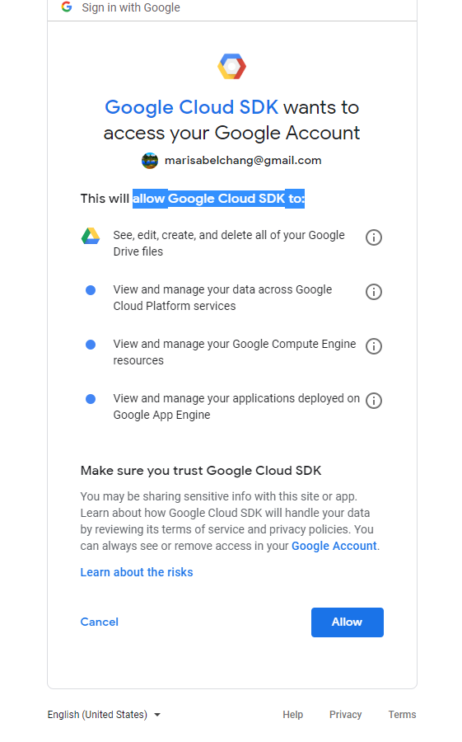
Permission
Allow Google Cloud SDK to get access to your google drive

Slide 14
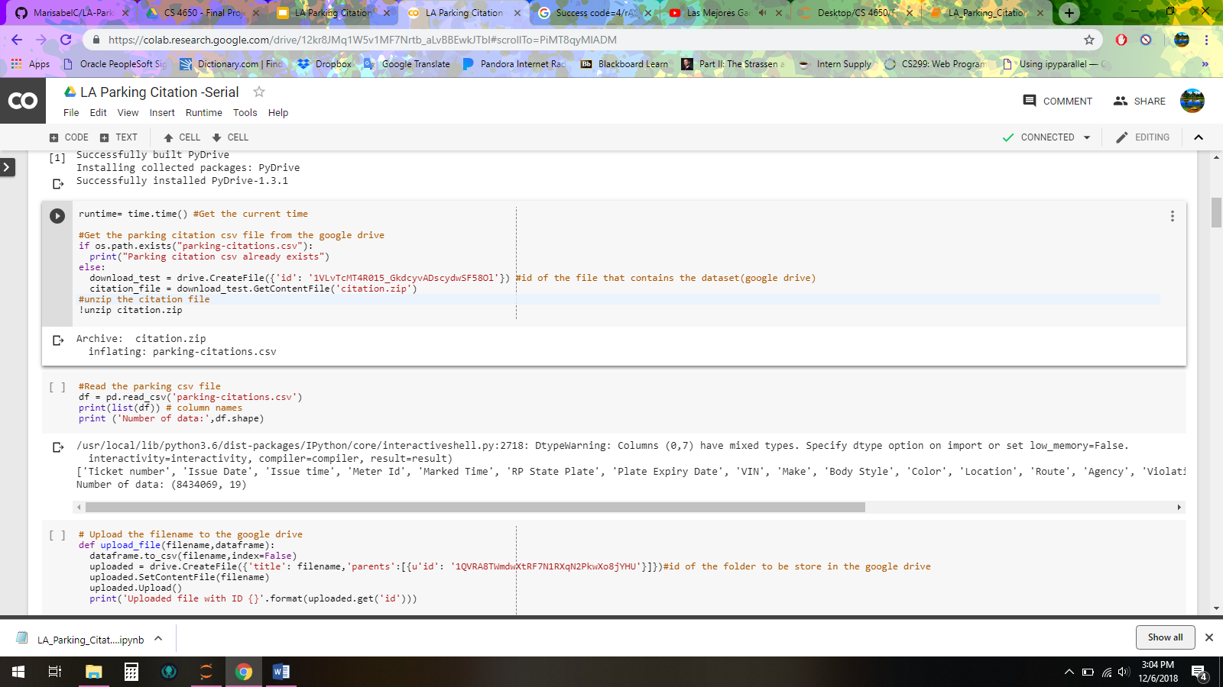
Download, Unzip and Read the dataset
Run These two blocks of code

Slide 15
Analyze data
Run the block of code that contains the data that you desire to analyze

